Slide 1

Komite Pwen Dlo (KPE)
Gid sa kreye pou edew navige tout konsol KPE and e gade ki fonsyonalite li gen ladanl.

Slide 2
Kijan pouw jwenn konsol la?
Entre sou page mWater an.
Entre nan potay HANWASH Home lan

Slide 3
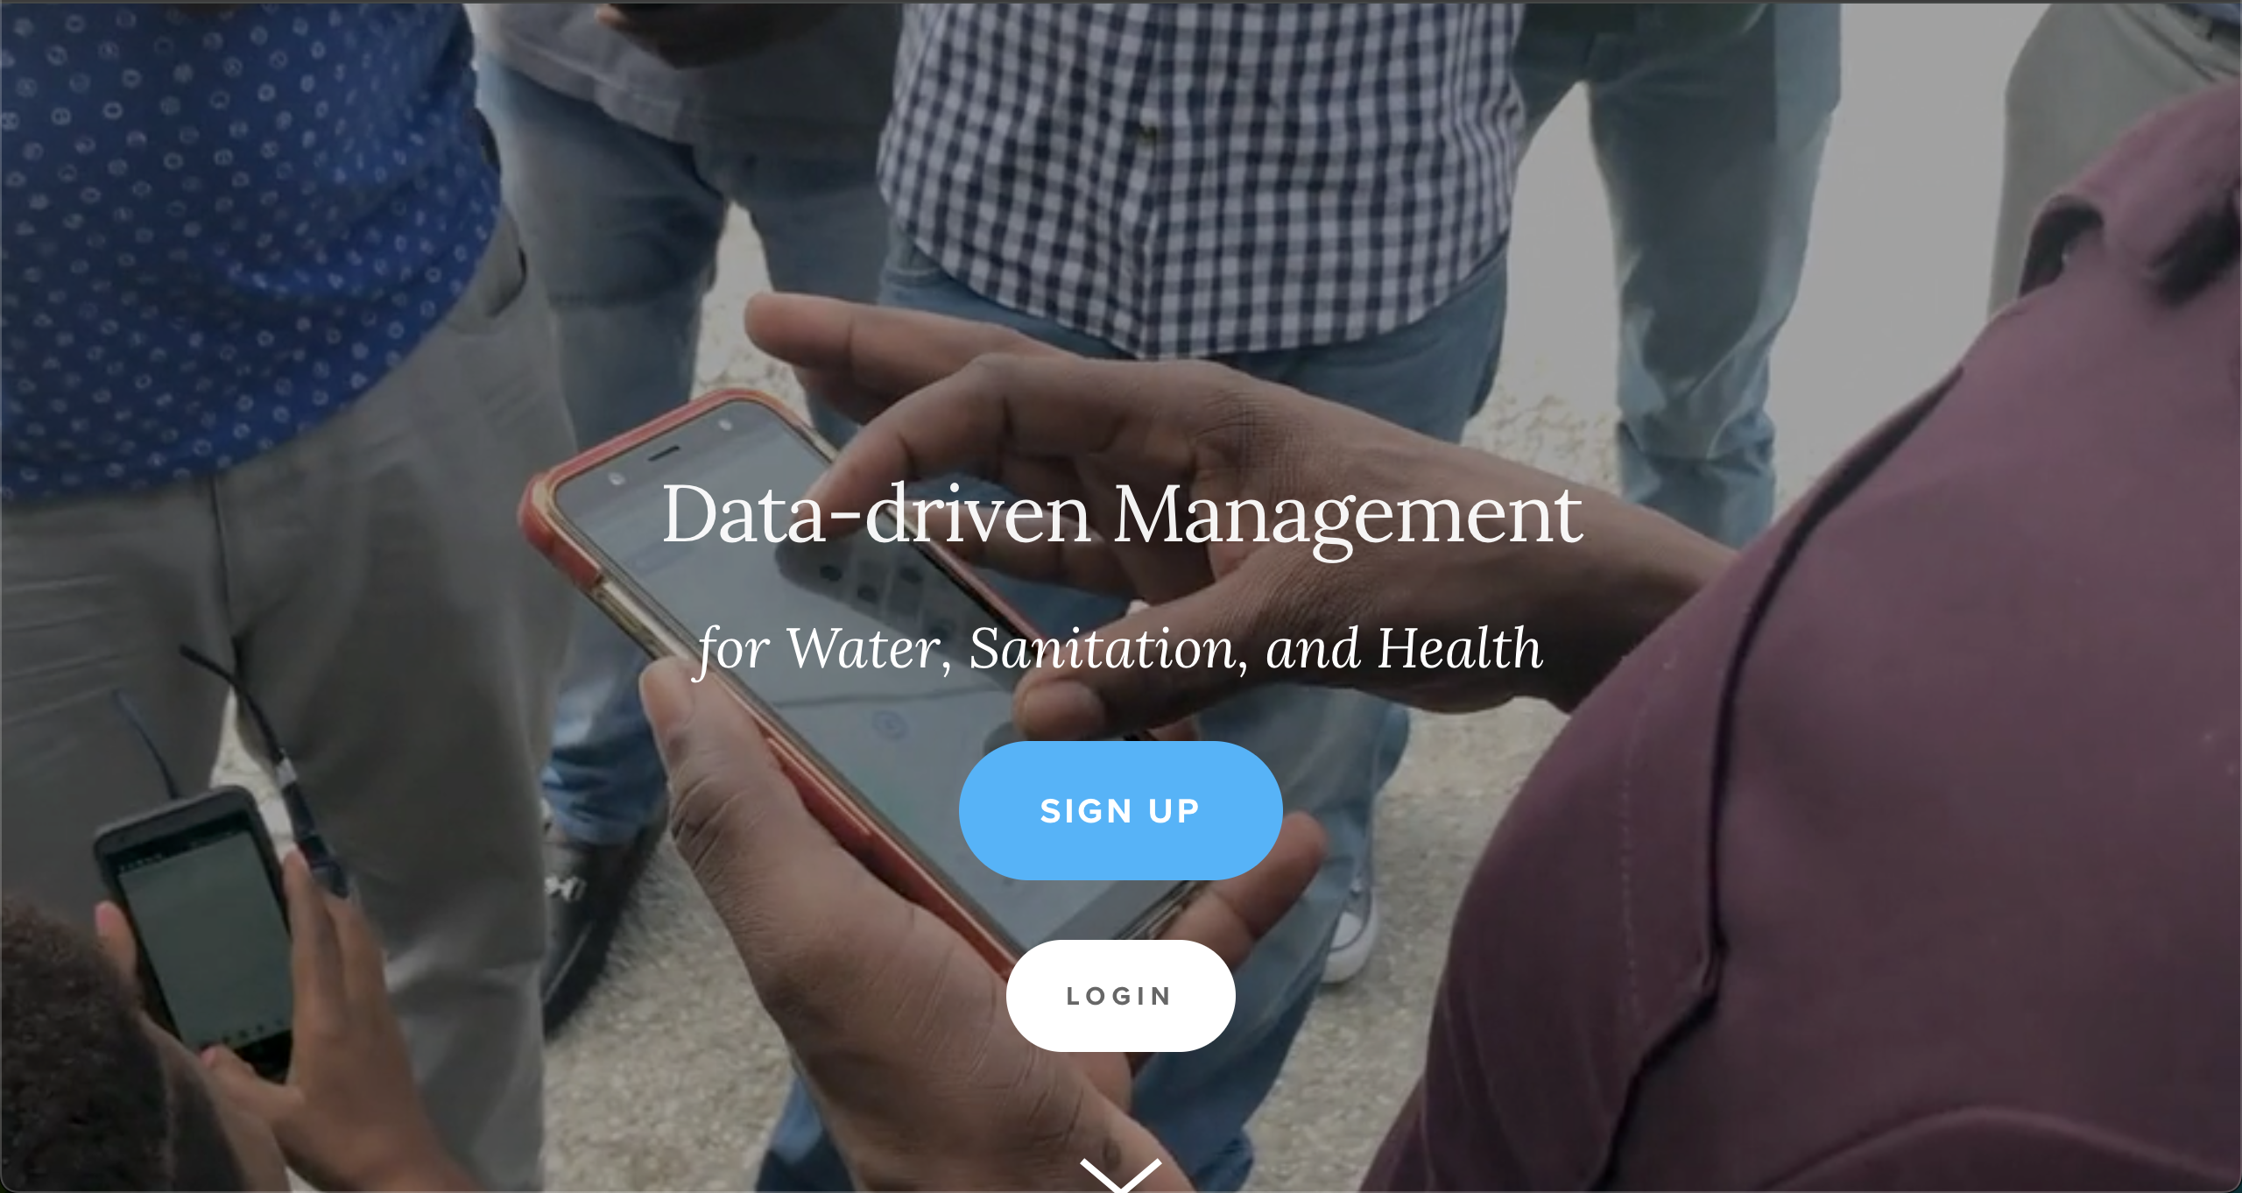
Paj Mwater
Lyen URL lan : https://www.mwater.co

Slide 4
Prosesus autorizasion
Clike sou button ki ecri Login lan.

Slide 5
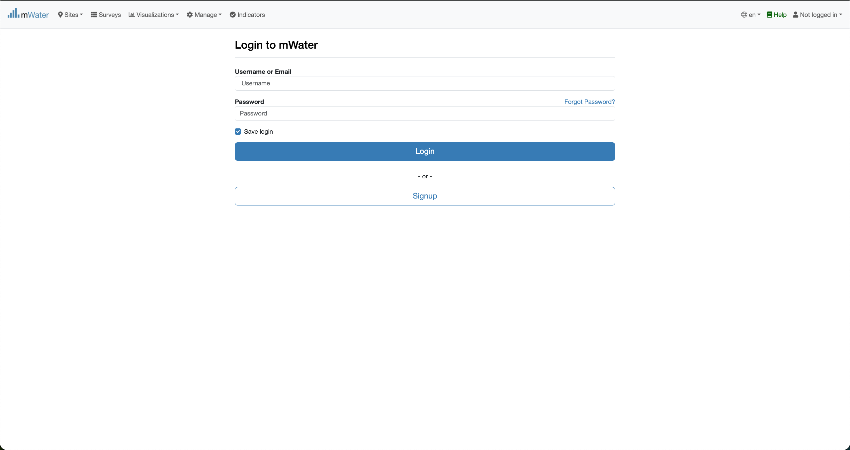
Prosesus autorizasion
Sa Indike ou poko identifyew sou system lan
Rempli fom sa avec email ou non itilisate ou et mo pass ou. Epi clike sou button Login lan.

Slide 6
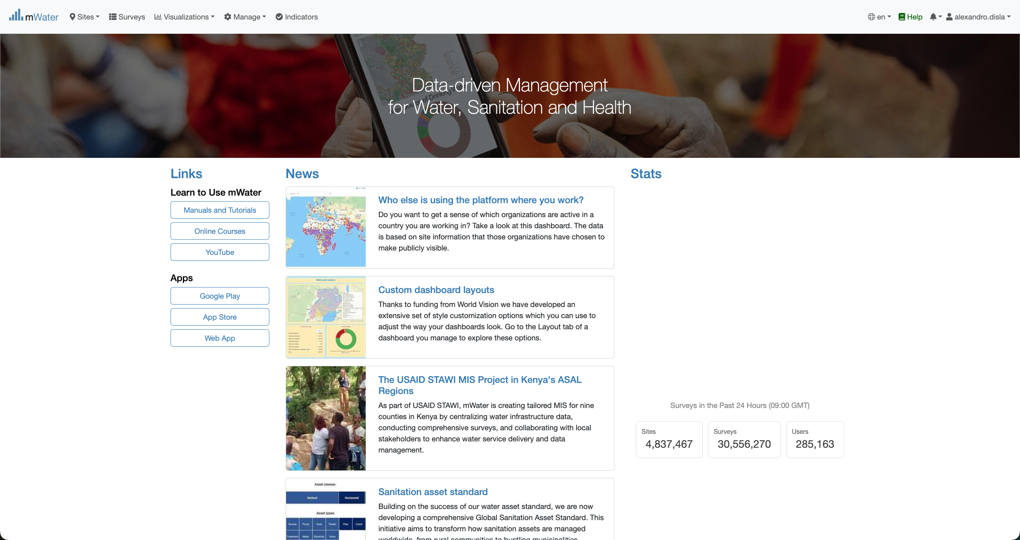
Paj AkEY Mwater
Ou bien identifyew sou mWater.

Slide 7
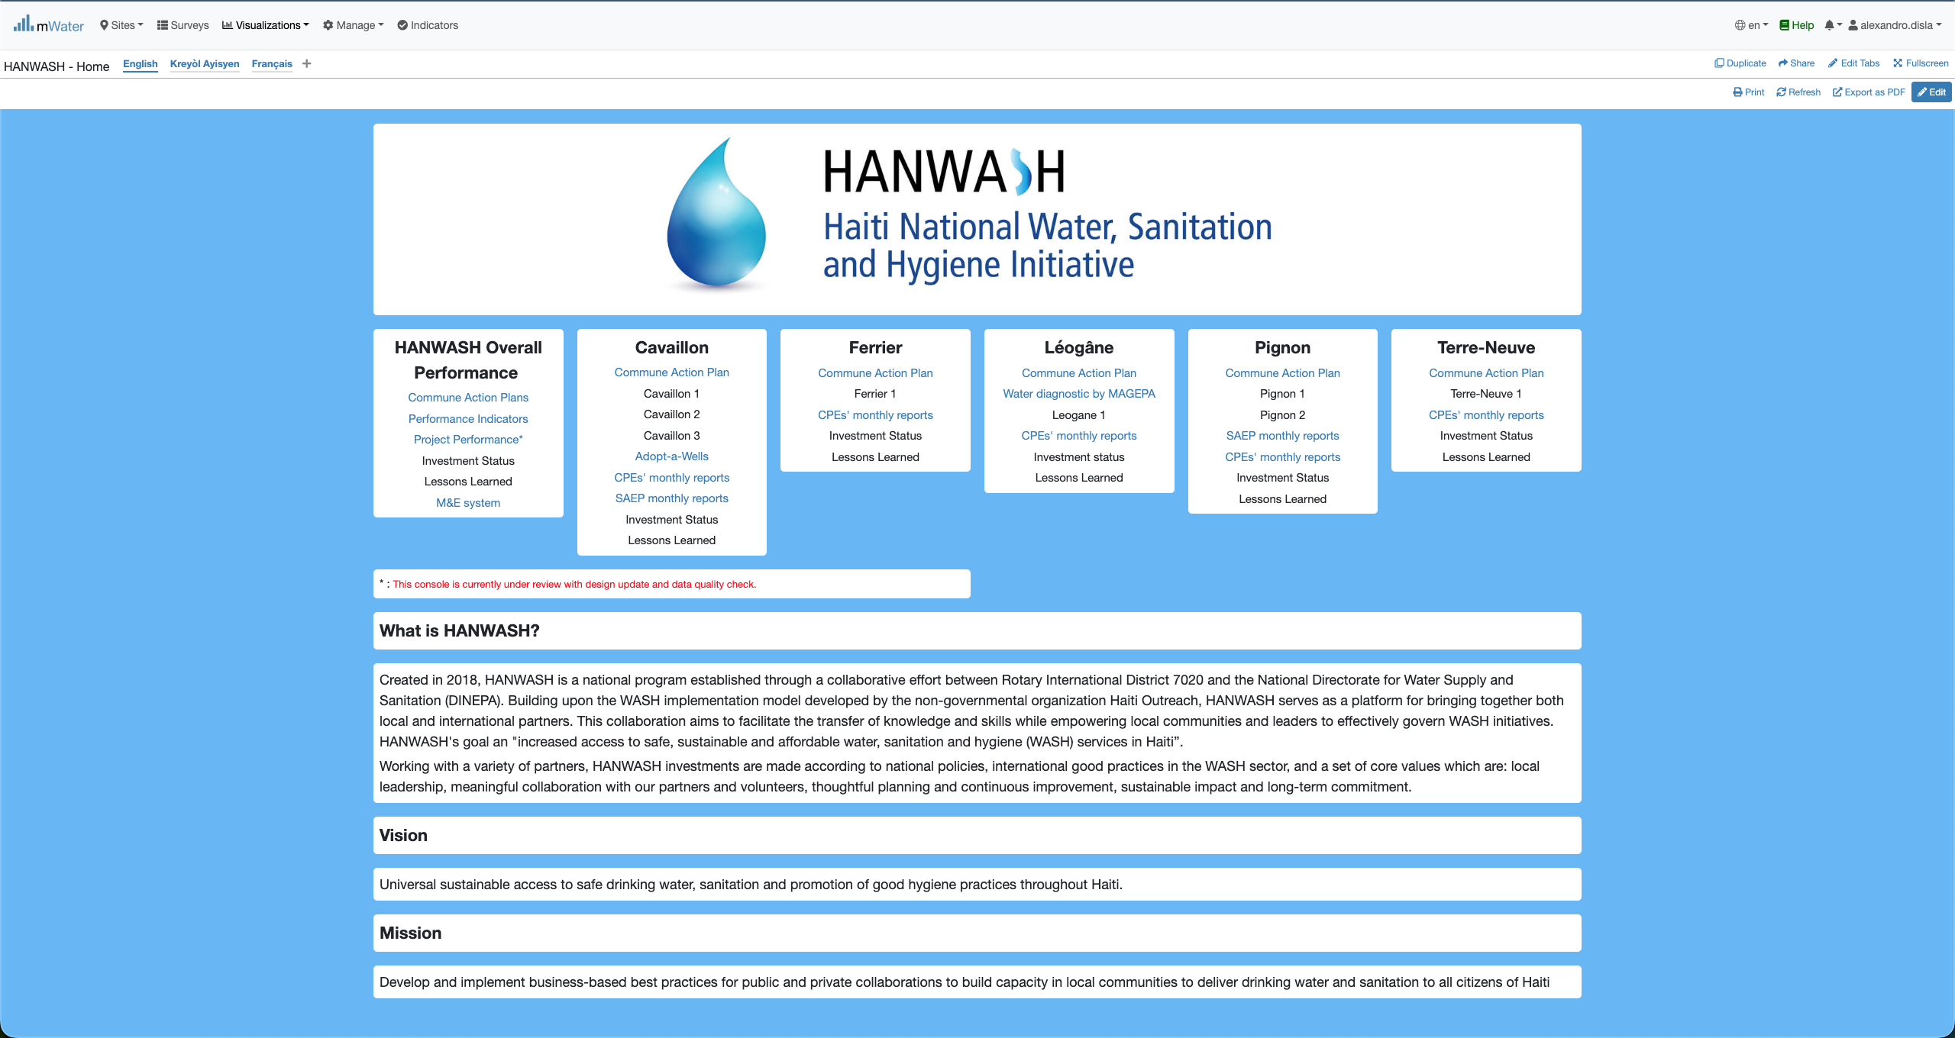
Hanwash HOME
Kounya ou met itilize lyen url sa ki amba pouw rive sou page HANWASH Home lan.
Lyen URL : http://go.mwater.co/hanwash

Slide 8
Access the CPE CONSOLES
Chak CPE sa yo mete en plas depann de komin lan. Par egzamp ou k clike sous CPE Cavaillon an.

Slide 9
KISA ki nan KONSOL lan
Konsol lan gen 2 paj, ou k rentre sou nimpot ladan yo siw vle.
1. CPE Reports (Vesyon Angle)
2. Rapport CPE (Vesyon FRANSE)
Sivouple rete sou paj Rapport CPE an.

Slide 10
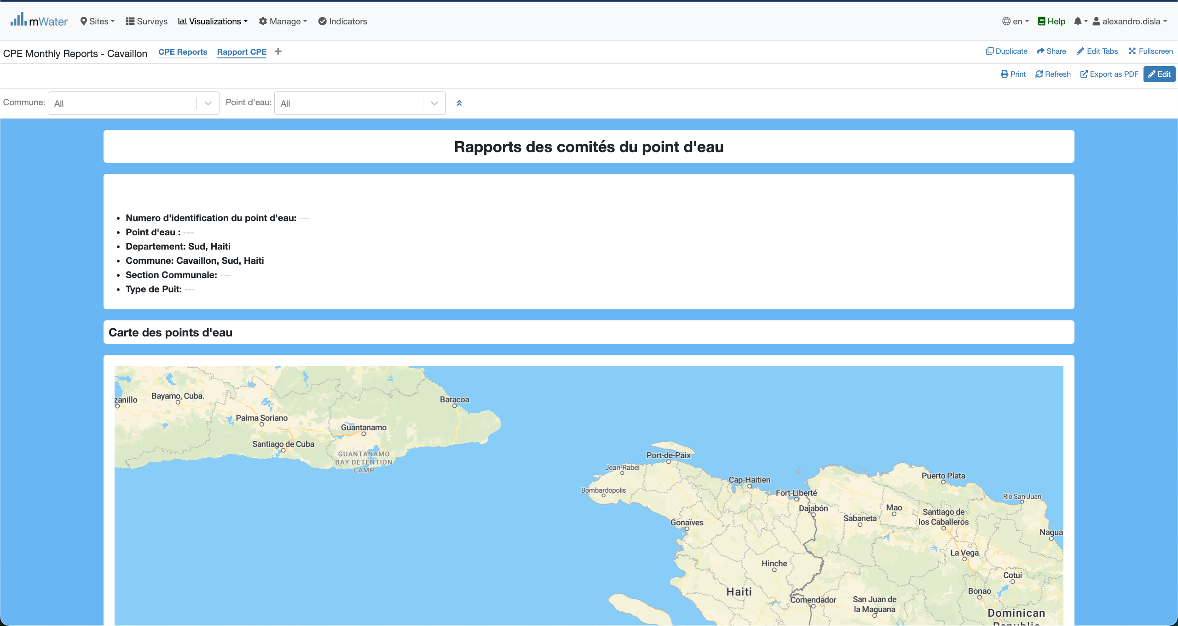
KONSOL lan
Clike sou sa yon fwa. Paske konsol la ap ouvri sou CPE reports lan, pa defo.

Slide 11
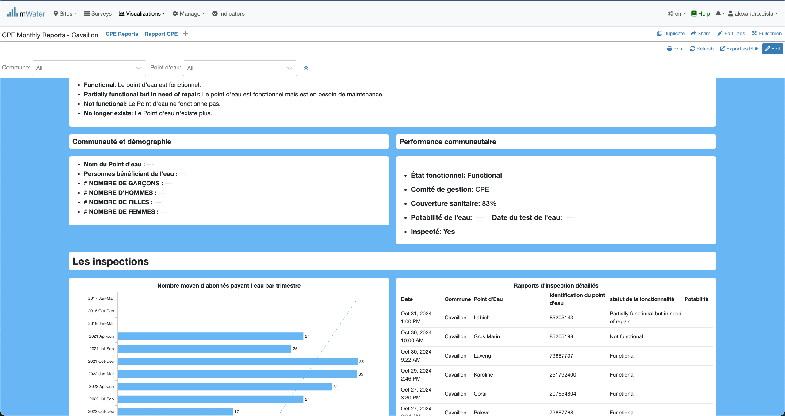
Konsol lan

Slide 12
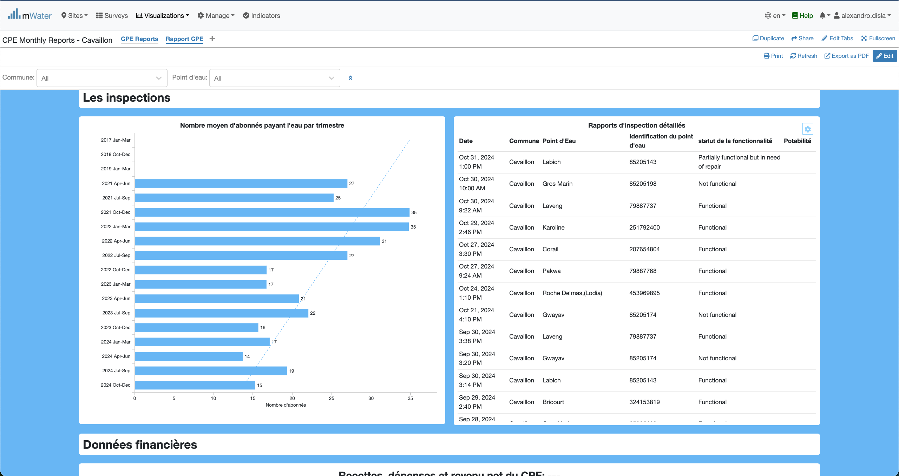
Konsol lan

Slide 13
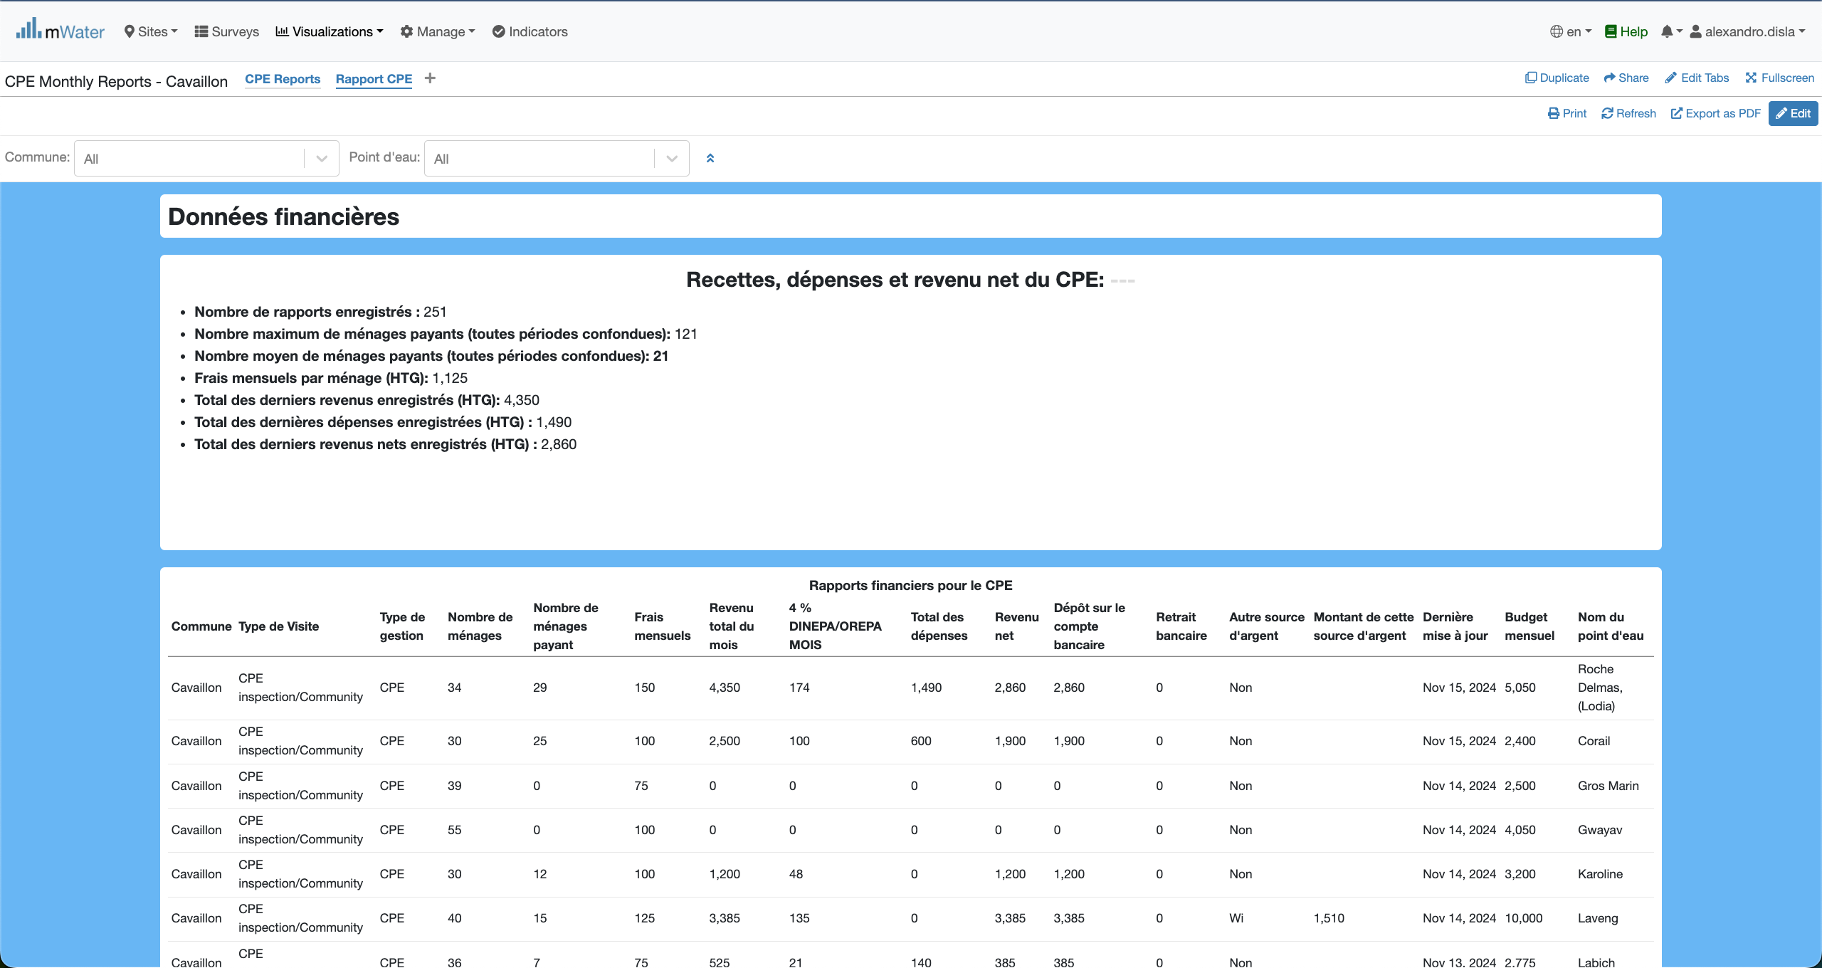
Konsol lan

Slide 14
Fonsyonalite
Kisa yo ye?

Slide 15
Rapport cpe
Rapport CPE:
Sektyon Antet
Sektyon Kat
Sektyon Kominote
Sektyon Inspektyon
Sektyon finans

Slide 16
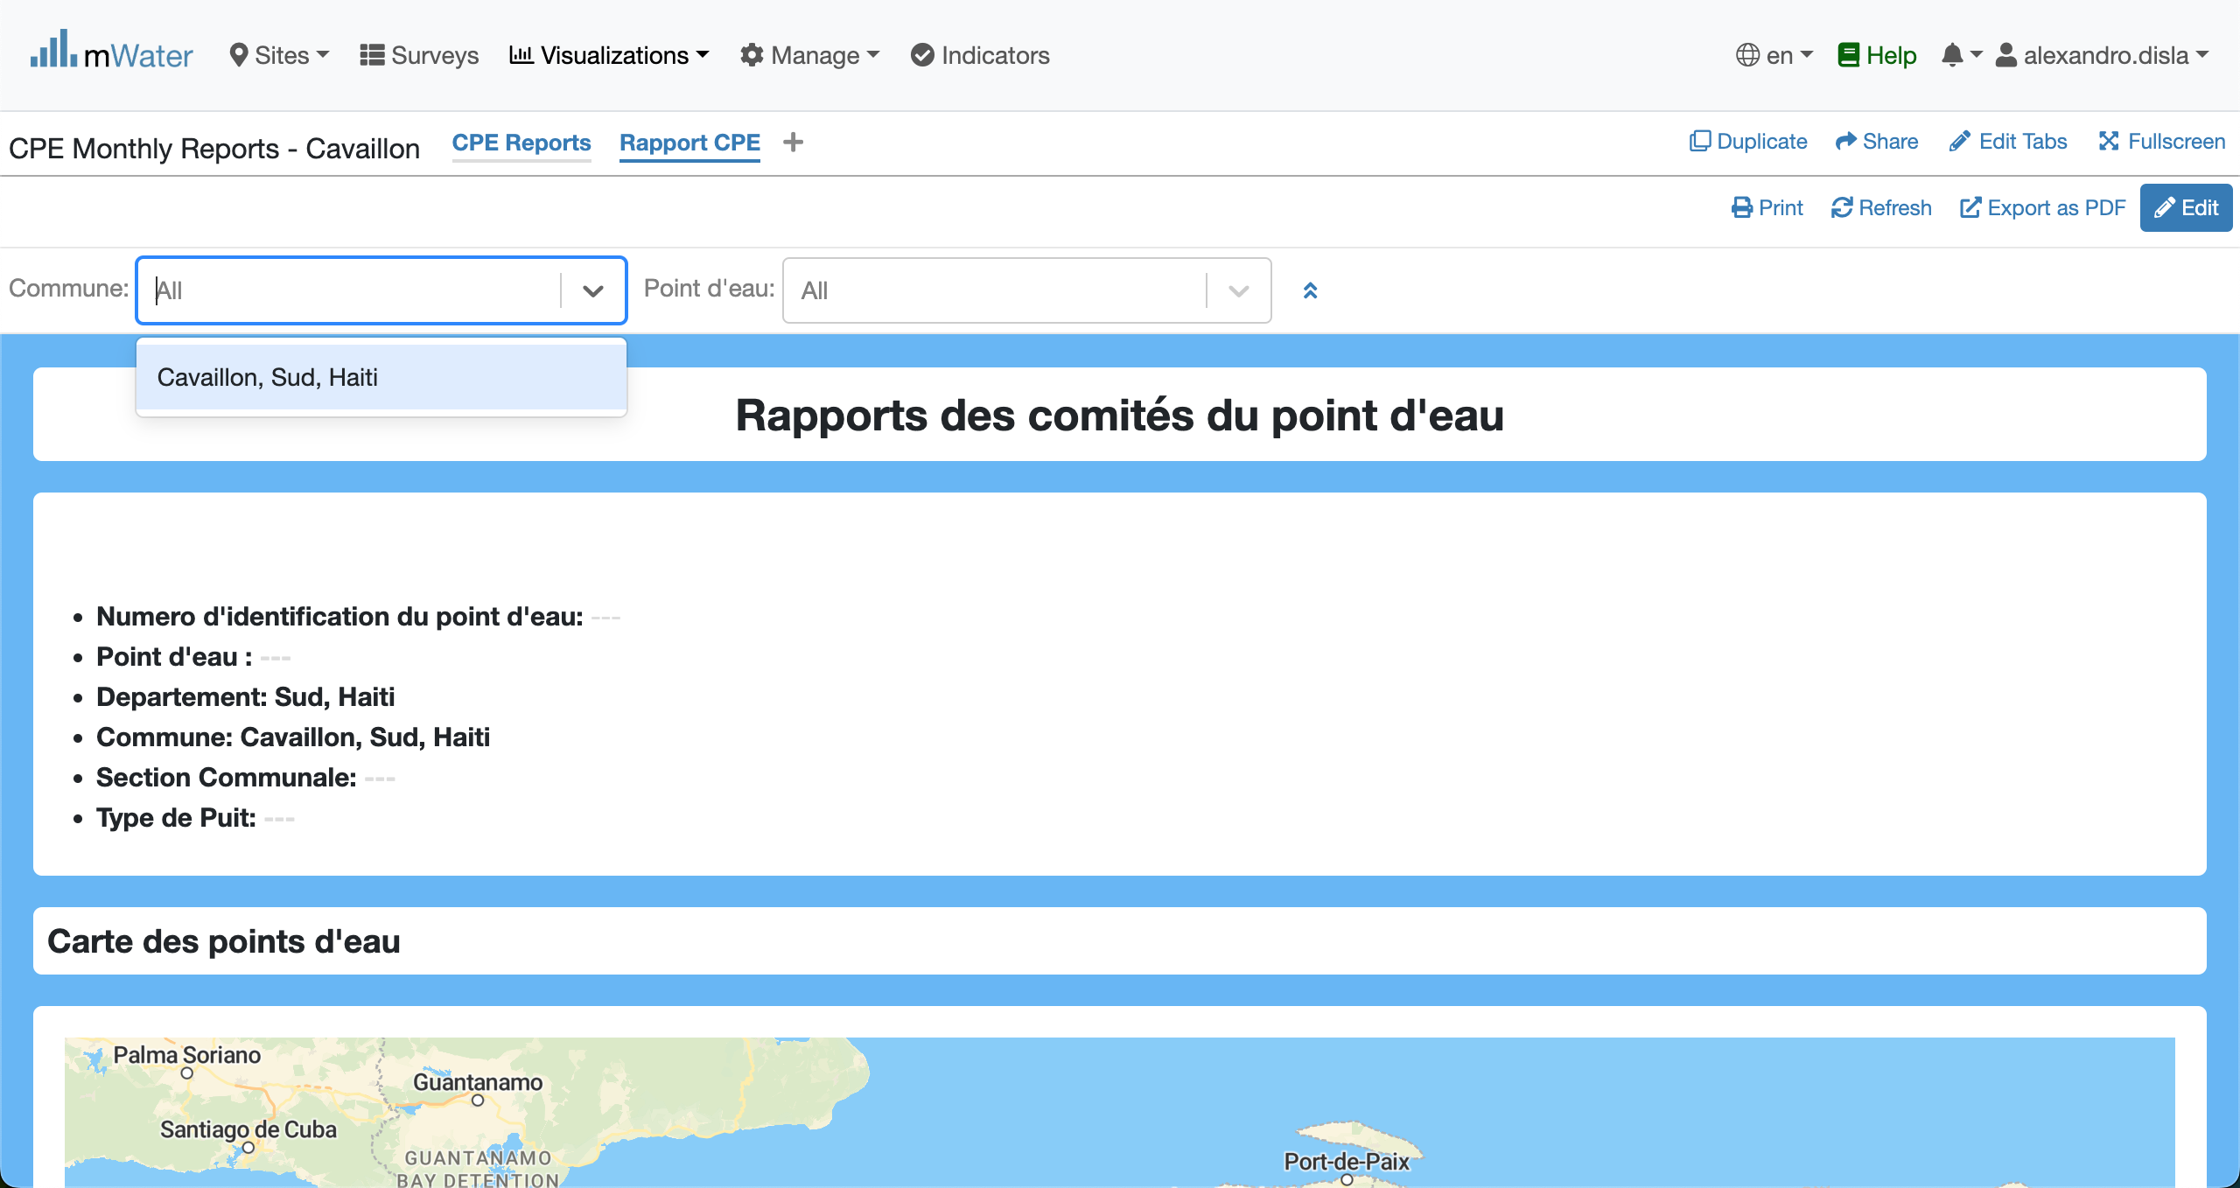
Opsyon ki nan antet
Pa defo, Nou mete opsyon komin lan sou Cavaillon

Slide 17
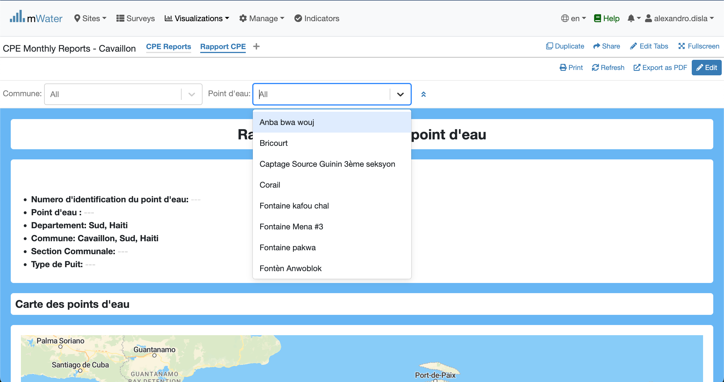
Opsyon ki nan ANtet
Tout pwen dlo ki anregistre pou komin Cavaillon yo la.

Slide 18
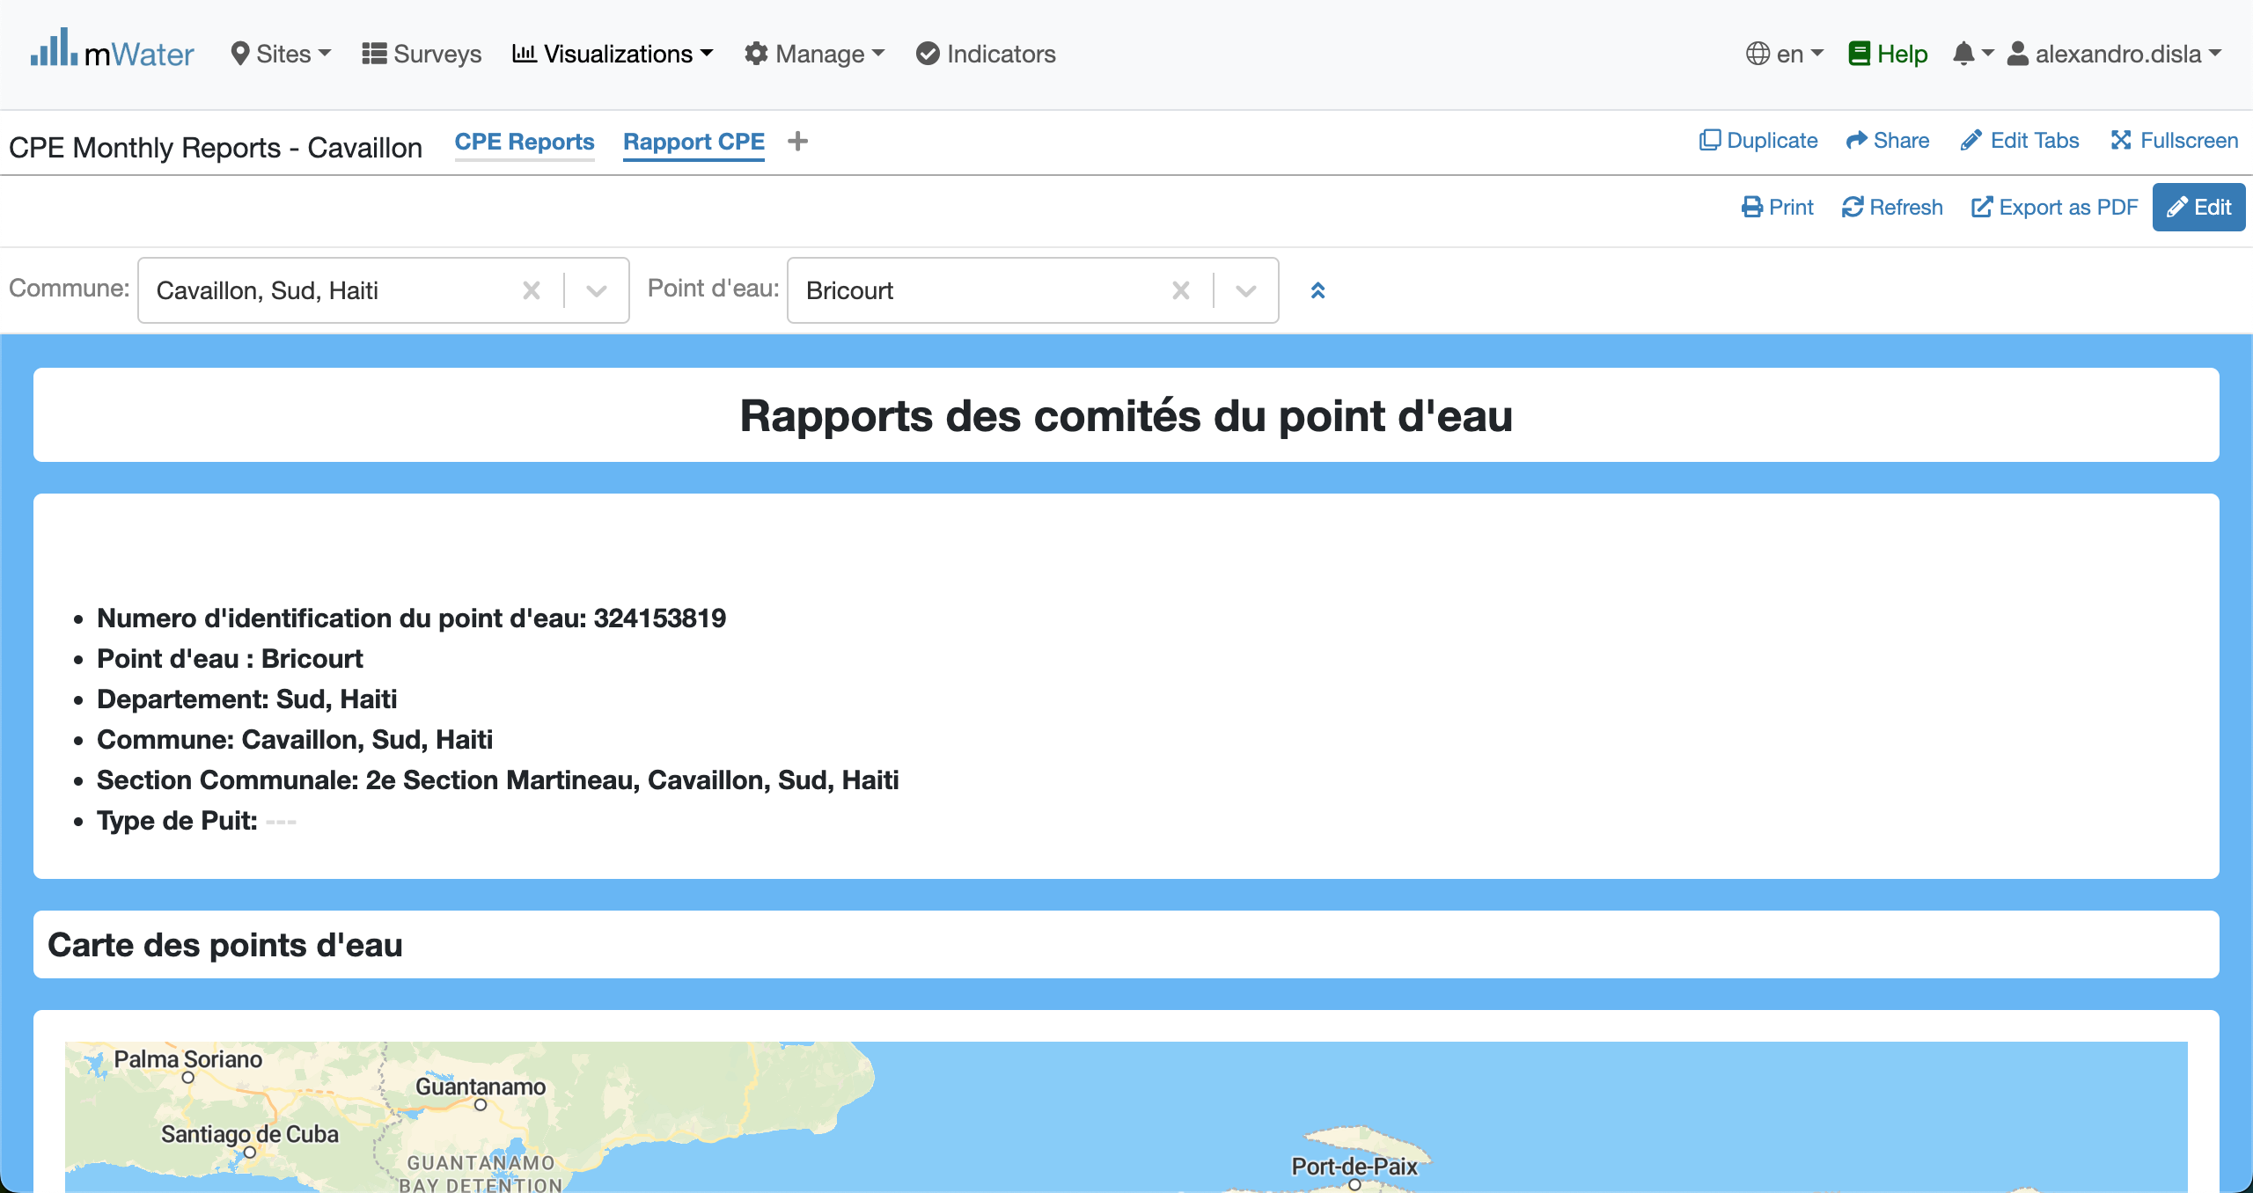
Afiche done nan konsol lan
With the quick filter active, the data will fill each section of the console. The header section display the common general information about the Water point.

Slide 19
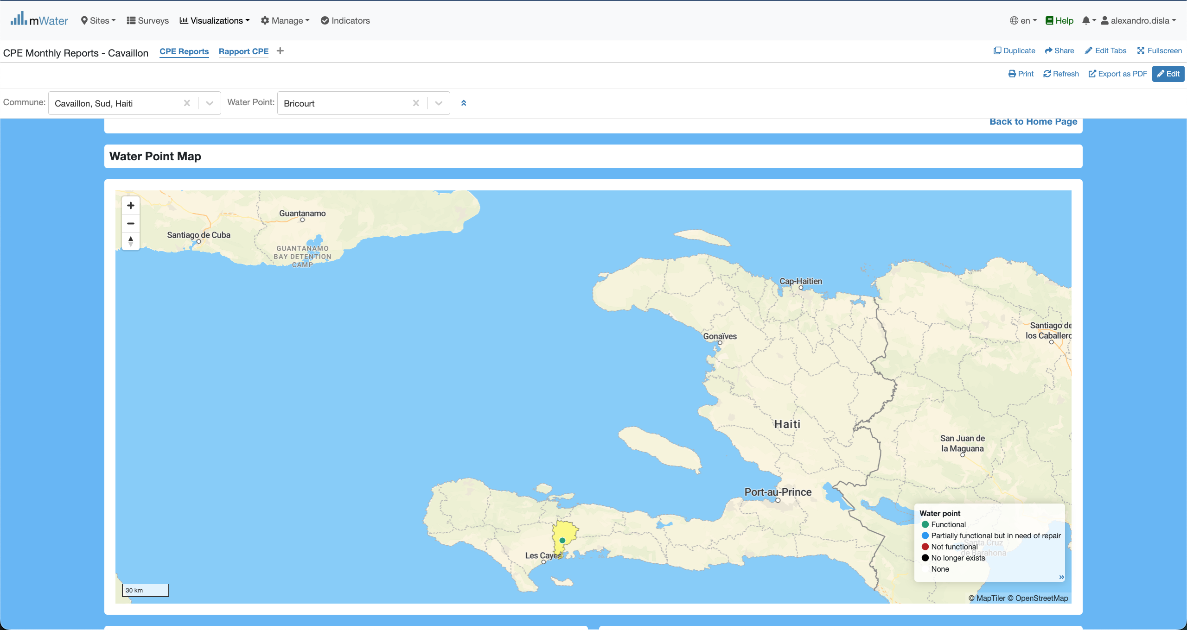
The MAP section
The Water Point is displayed in the map. The color of the water point will be rendered given the functionality status. And you can see the colored area of the commune.
You can click the water point. A modal will pop up with detailed information.

Slide 20
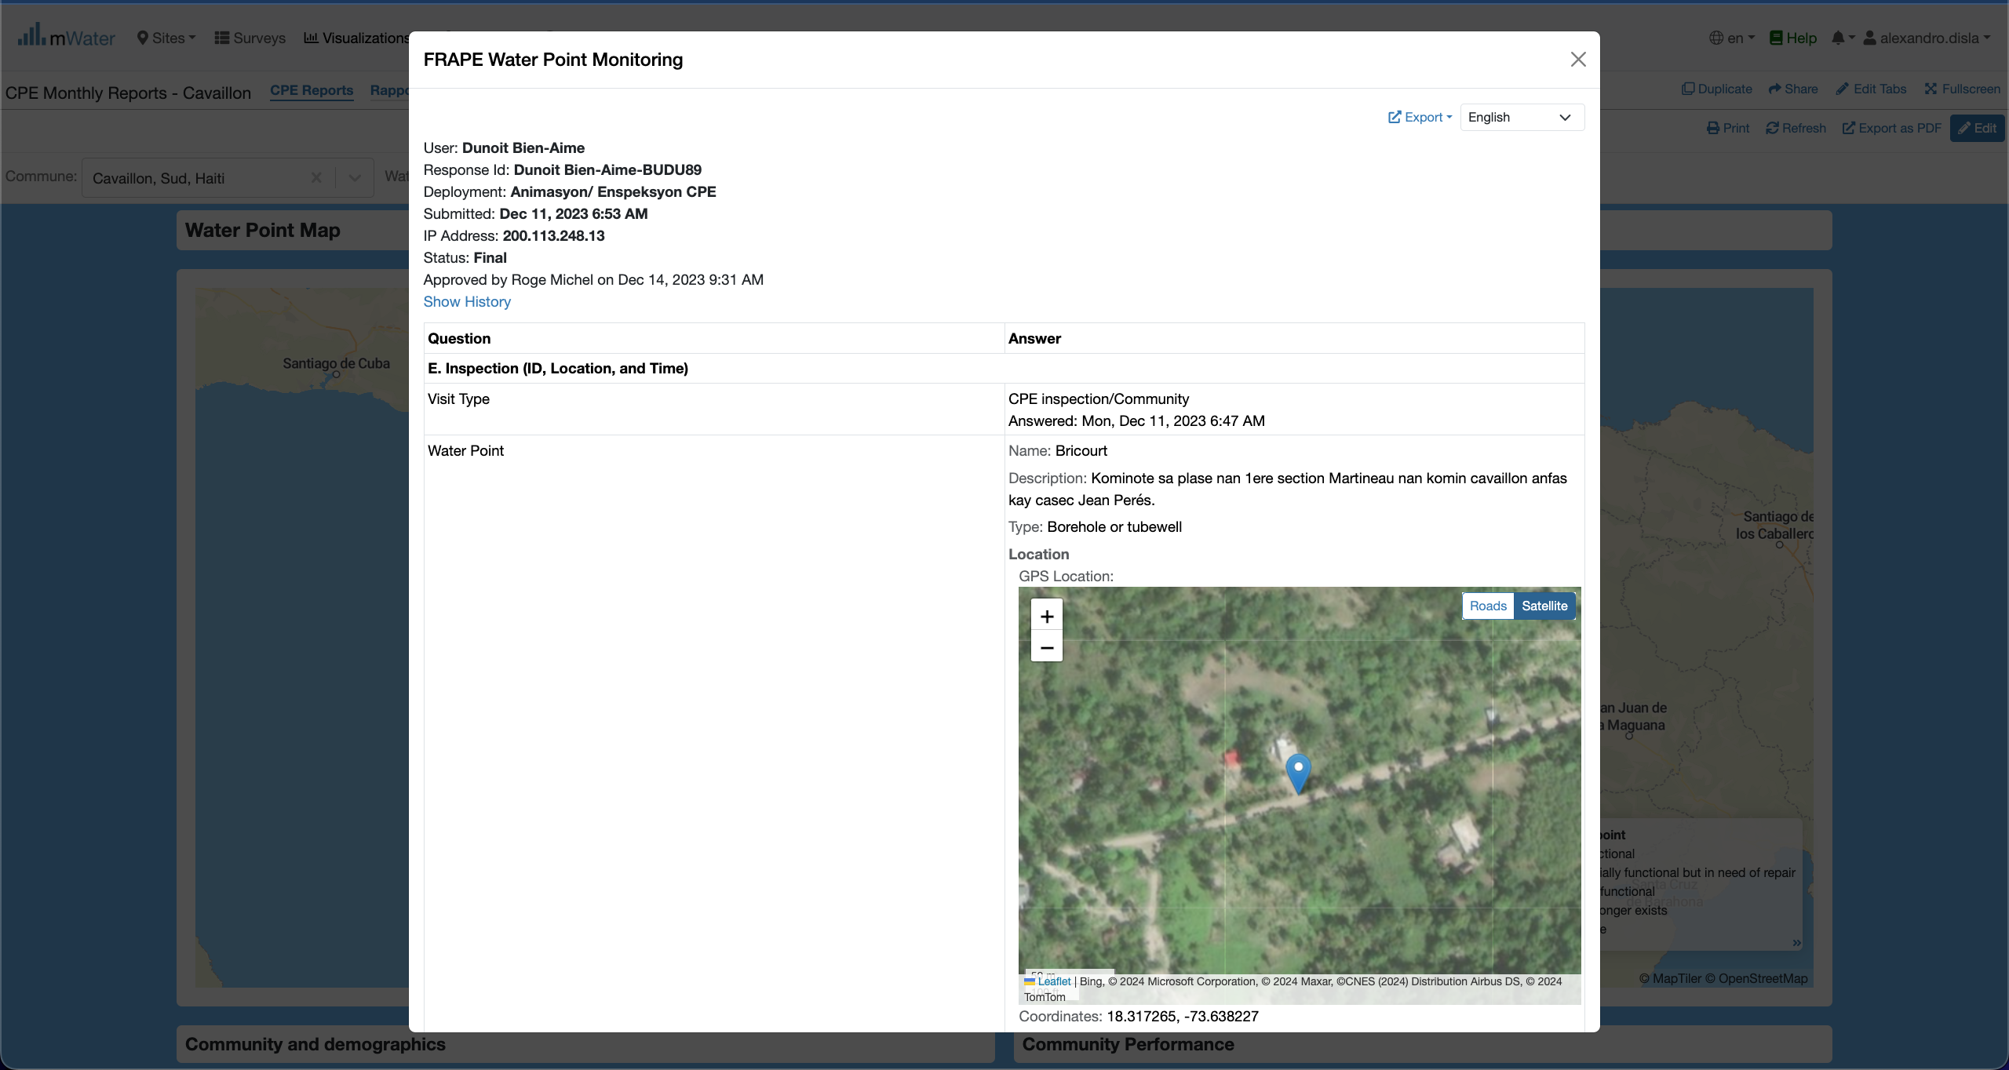
The Map section
Here is the modal response. This will show the report registered for the water point.

Slide 21
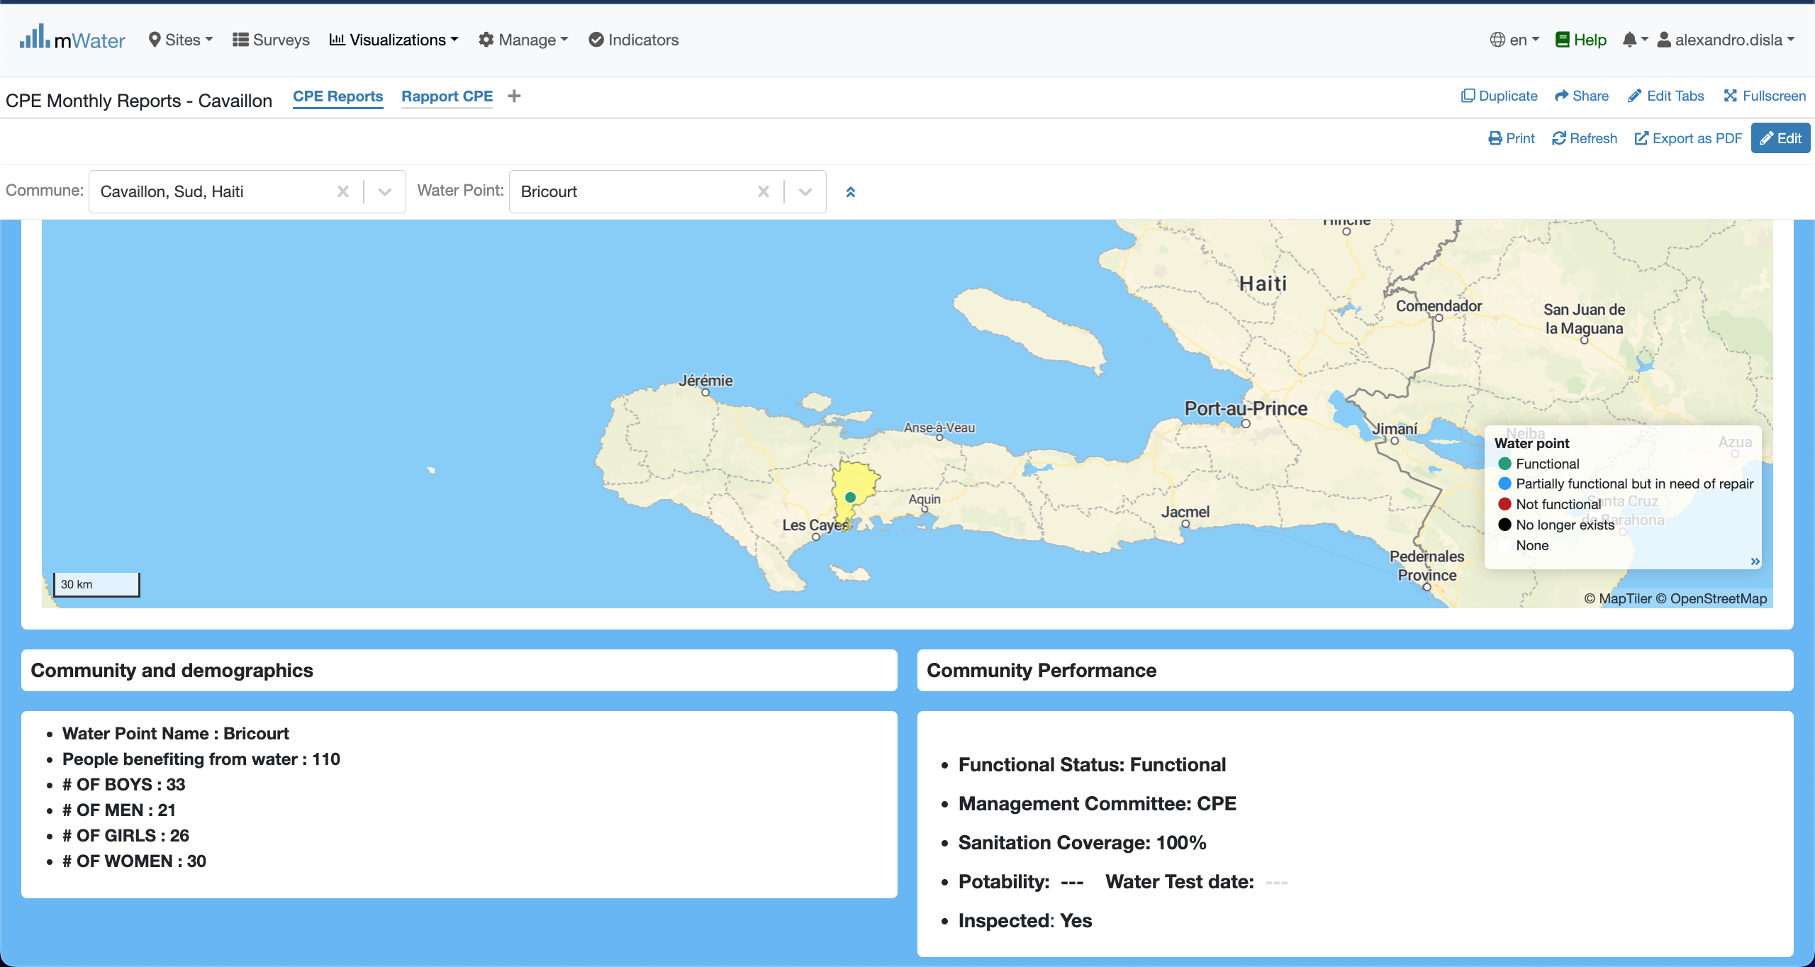
Community section
This section has two components: 1. with demographic information.
2. With the performance informance.

Slide 22
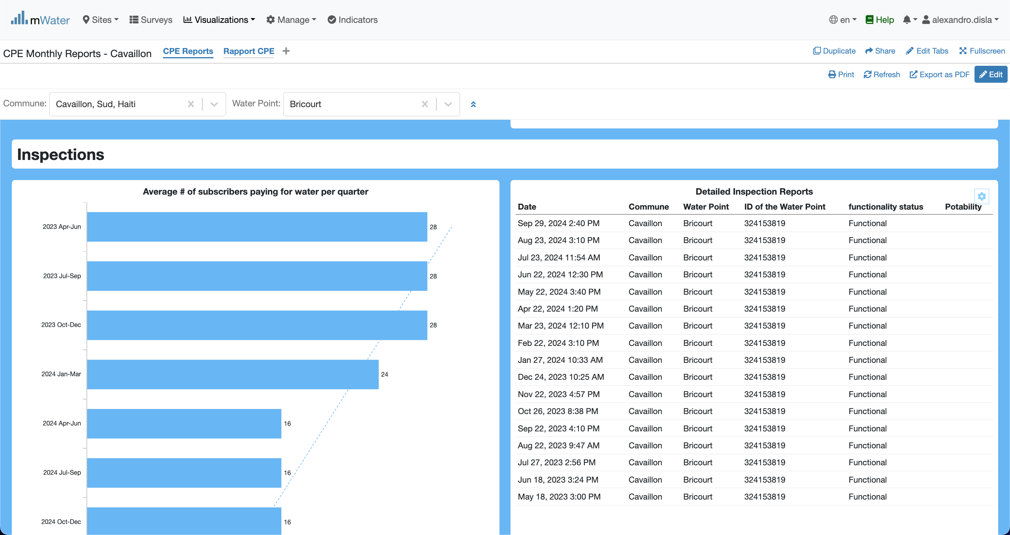
Inspections section
In this table you can see the diverse inpection detailed register. Just like the map, you can click on the row to display the report in a modal.
The graphic display the average water payments by subscribers for a given quarter.

Slide 23
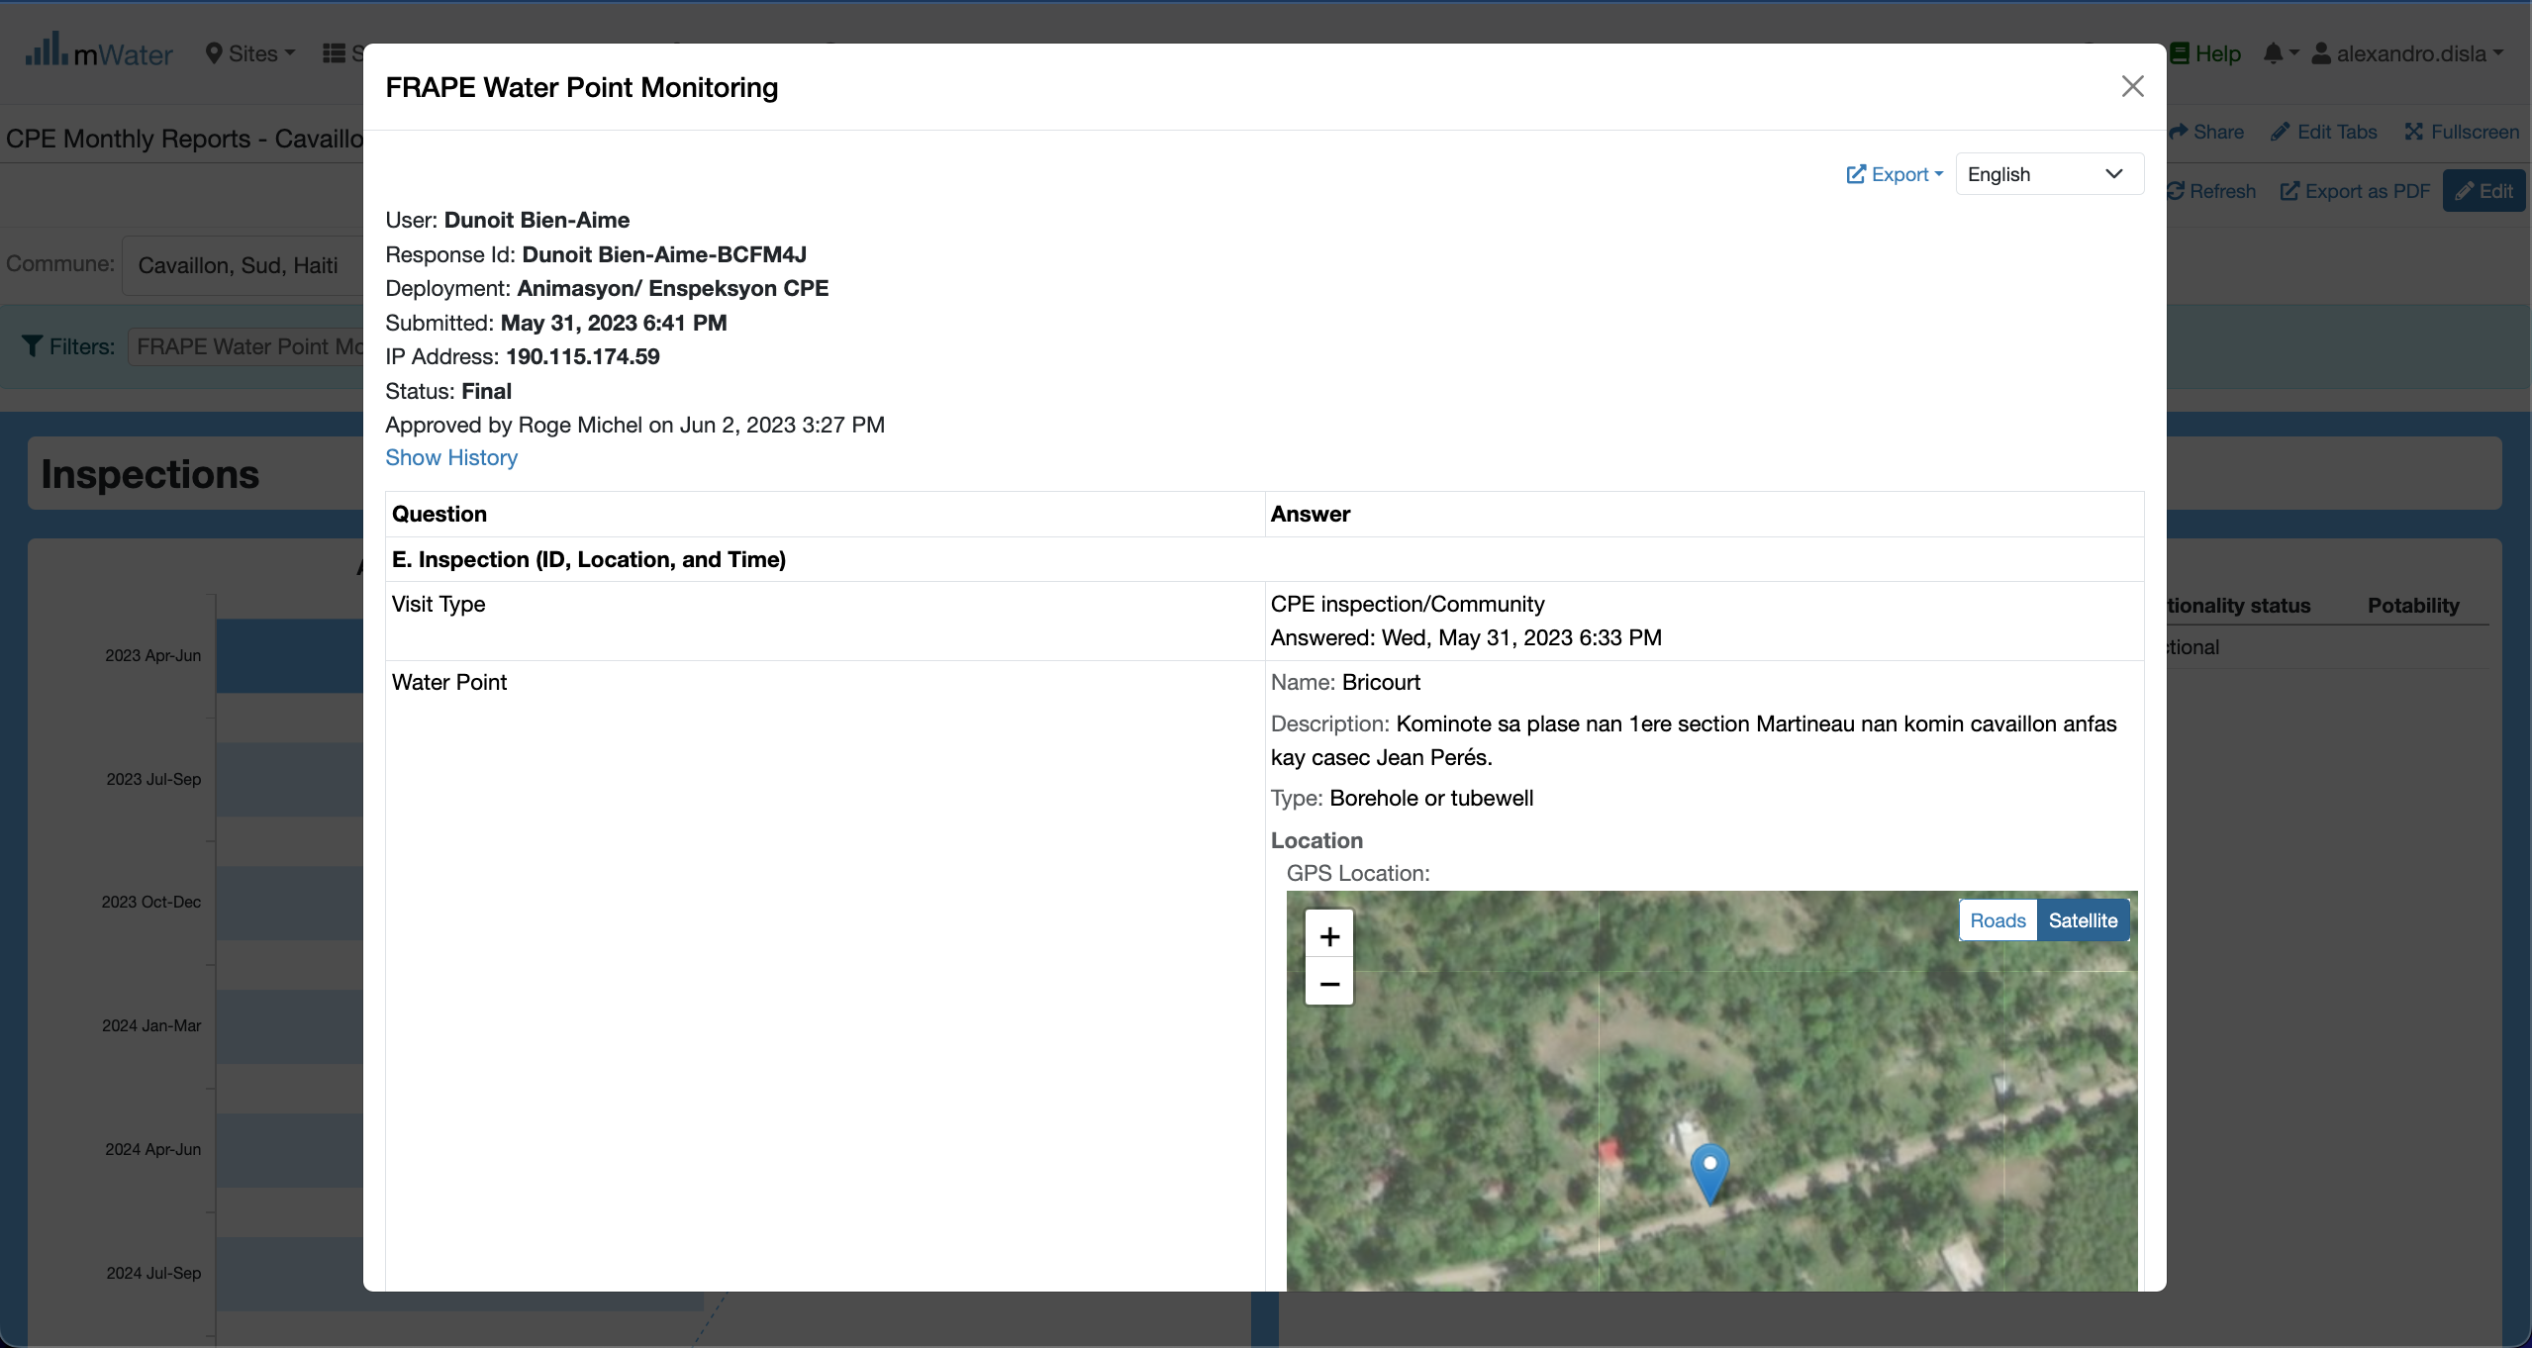
Inspections section
The modal structure is the same. However the actual report is different given the date of the report selected.

Slide 24
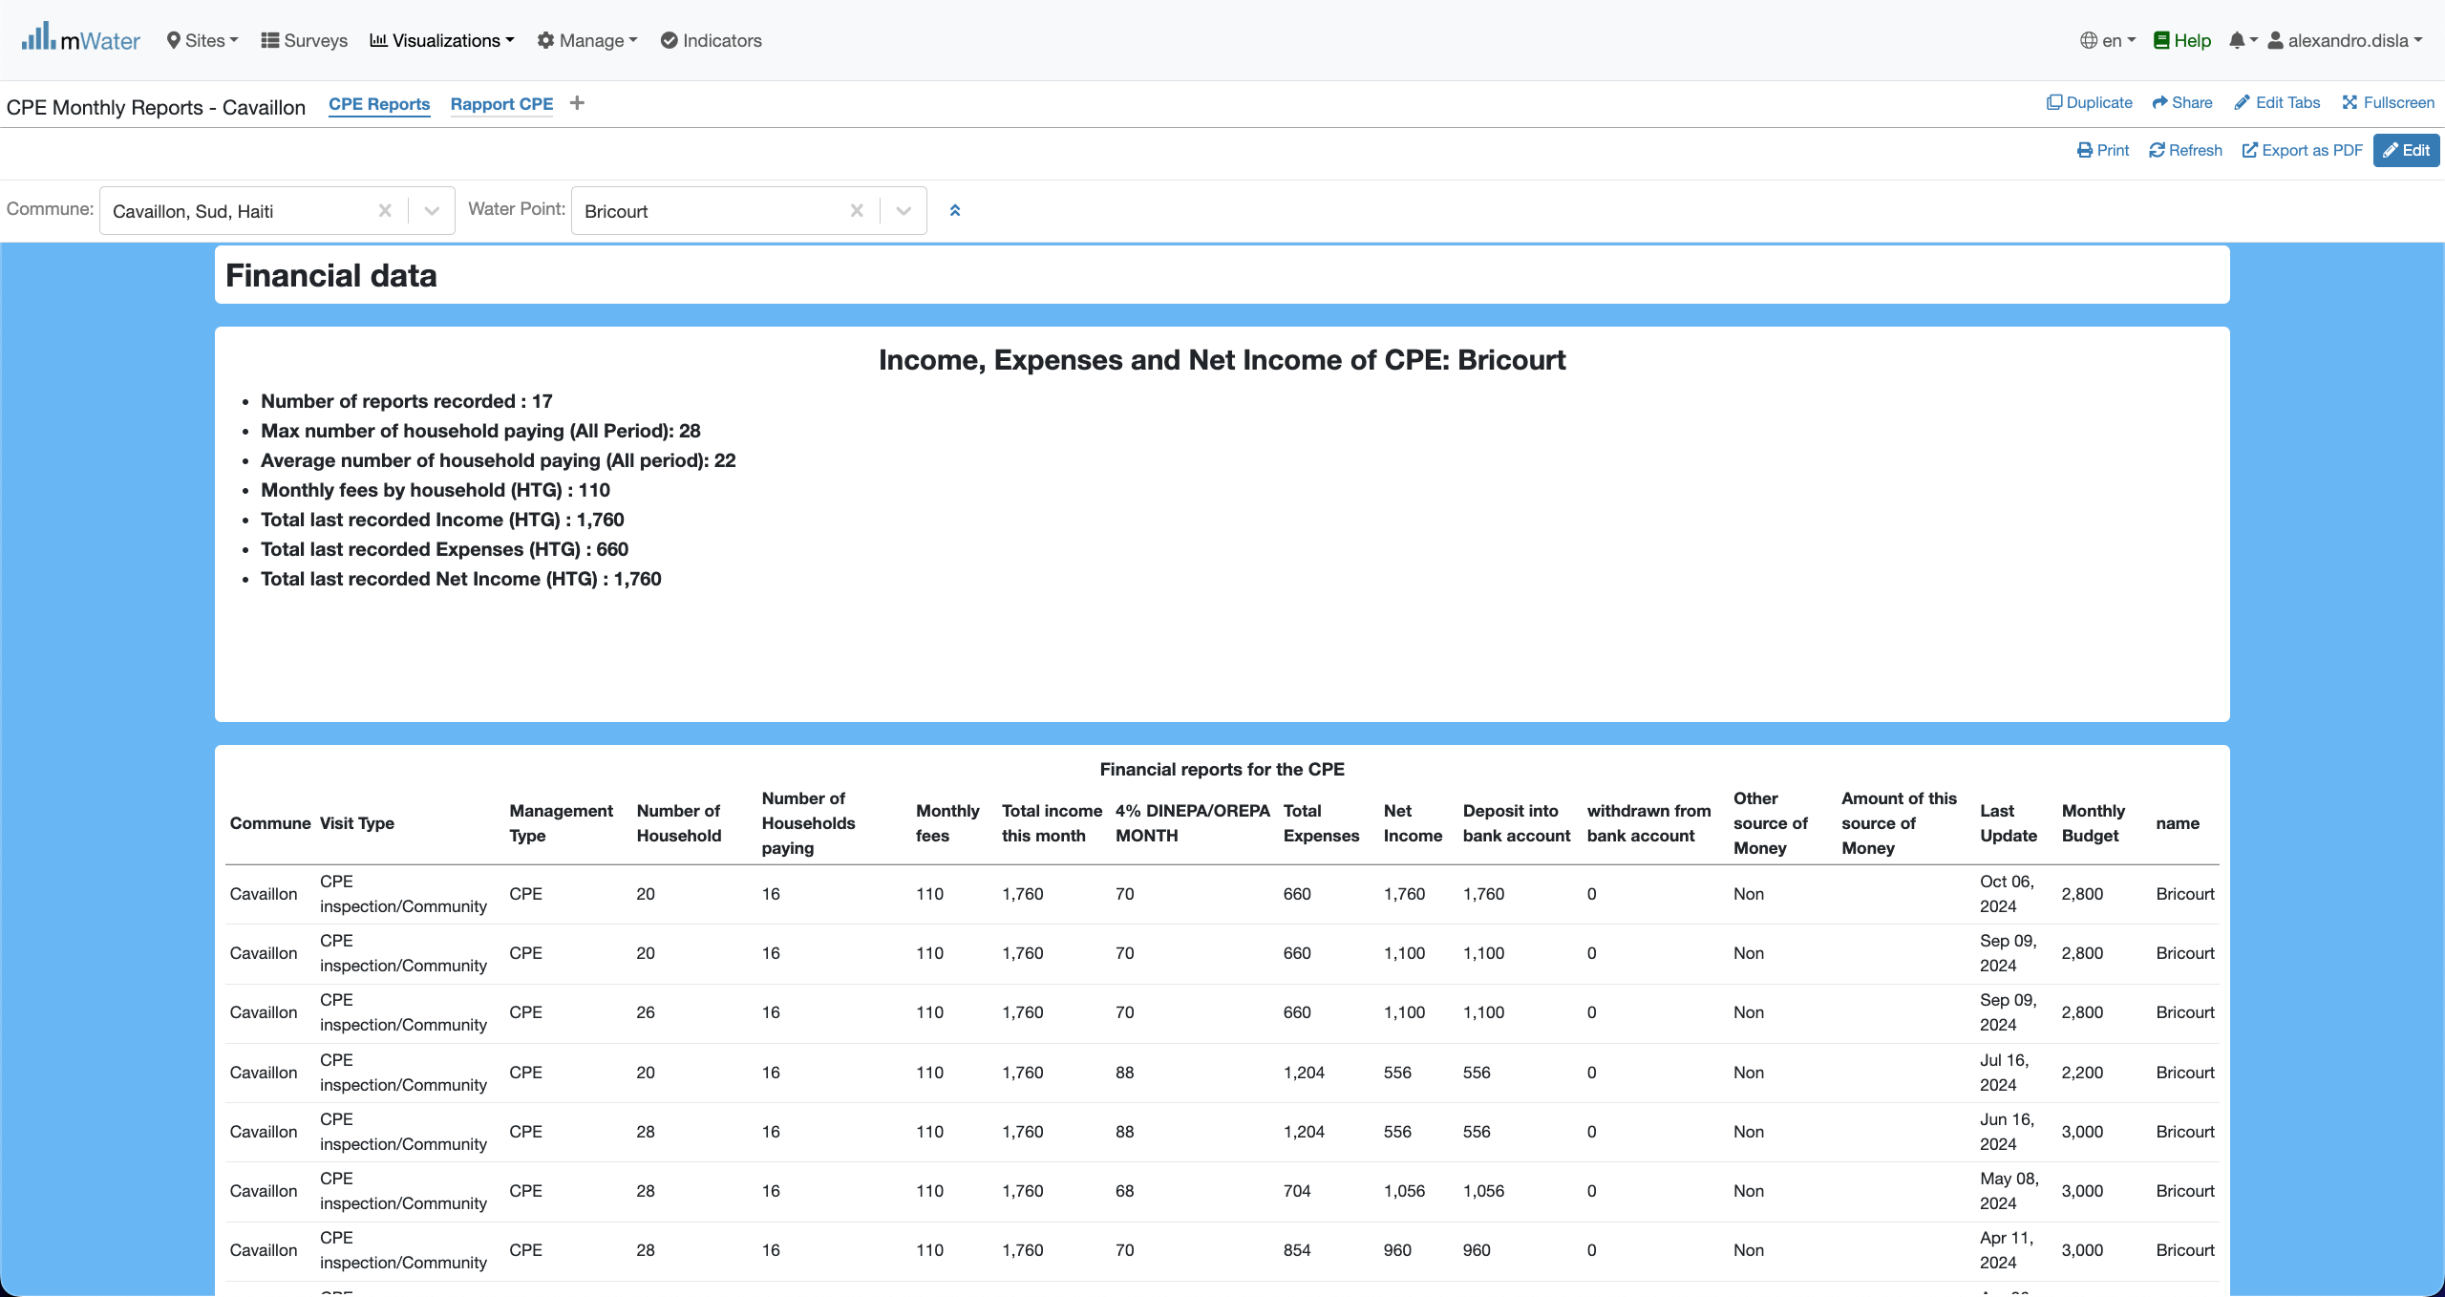
Financial section
These two component below the essantials of the financial information for the Water Point Committee activities.

Slide 25
Export

Slide 26
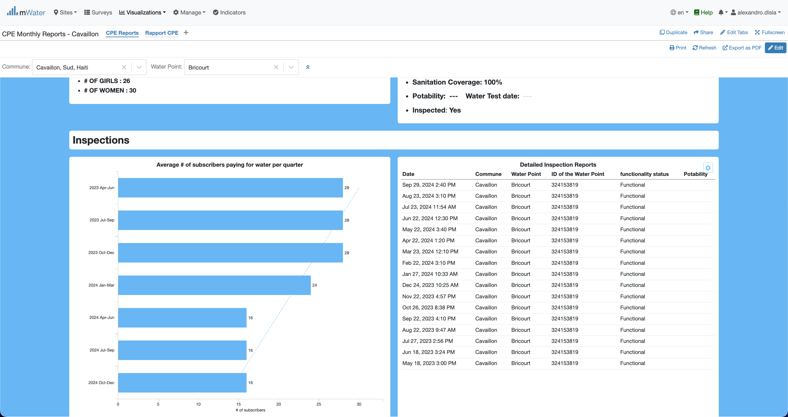
You can export a table
Hover you mouse on the table. The button will appear and you click on it.

Slide 27

You can export a table
Now you can click the export data button to get into the next final step

Slide 28
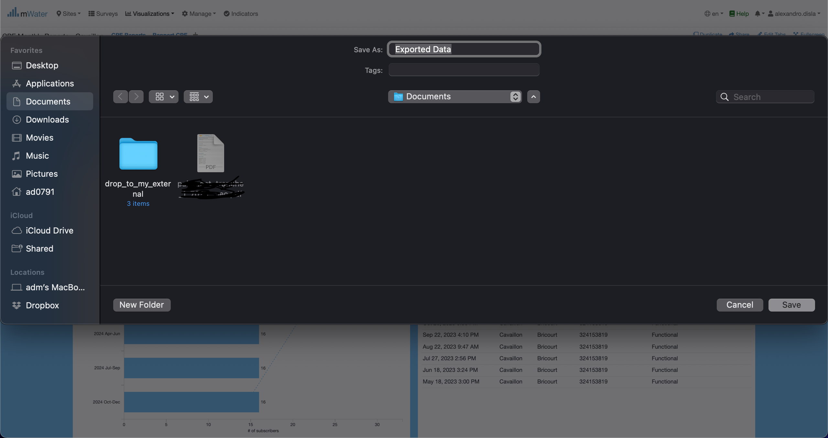
You can export a table
Since I am using a macos. Your interface might be different. You can change the name of the export table as you see fit. After that you can choose to cancel or save the document. By default, in macos it will save the document (spreadsheet) into the Documents folder.

Slide 29
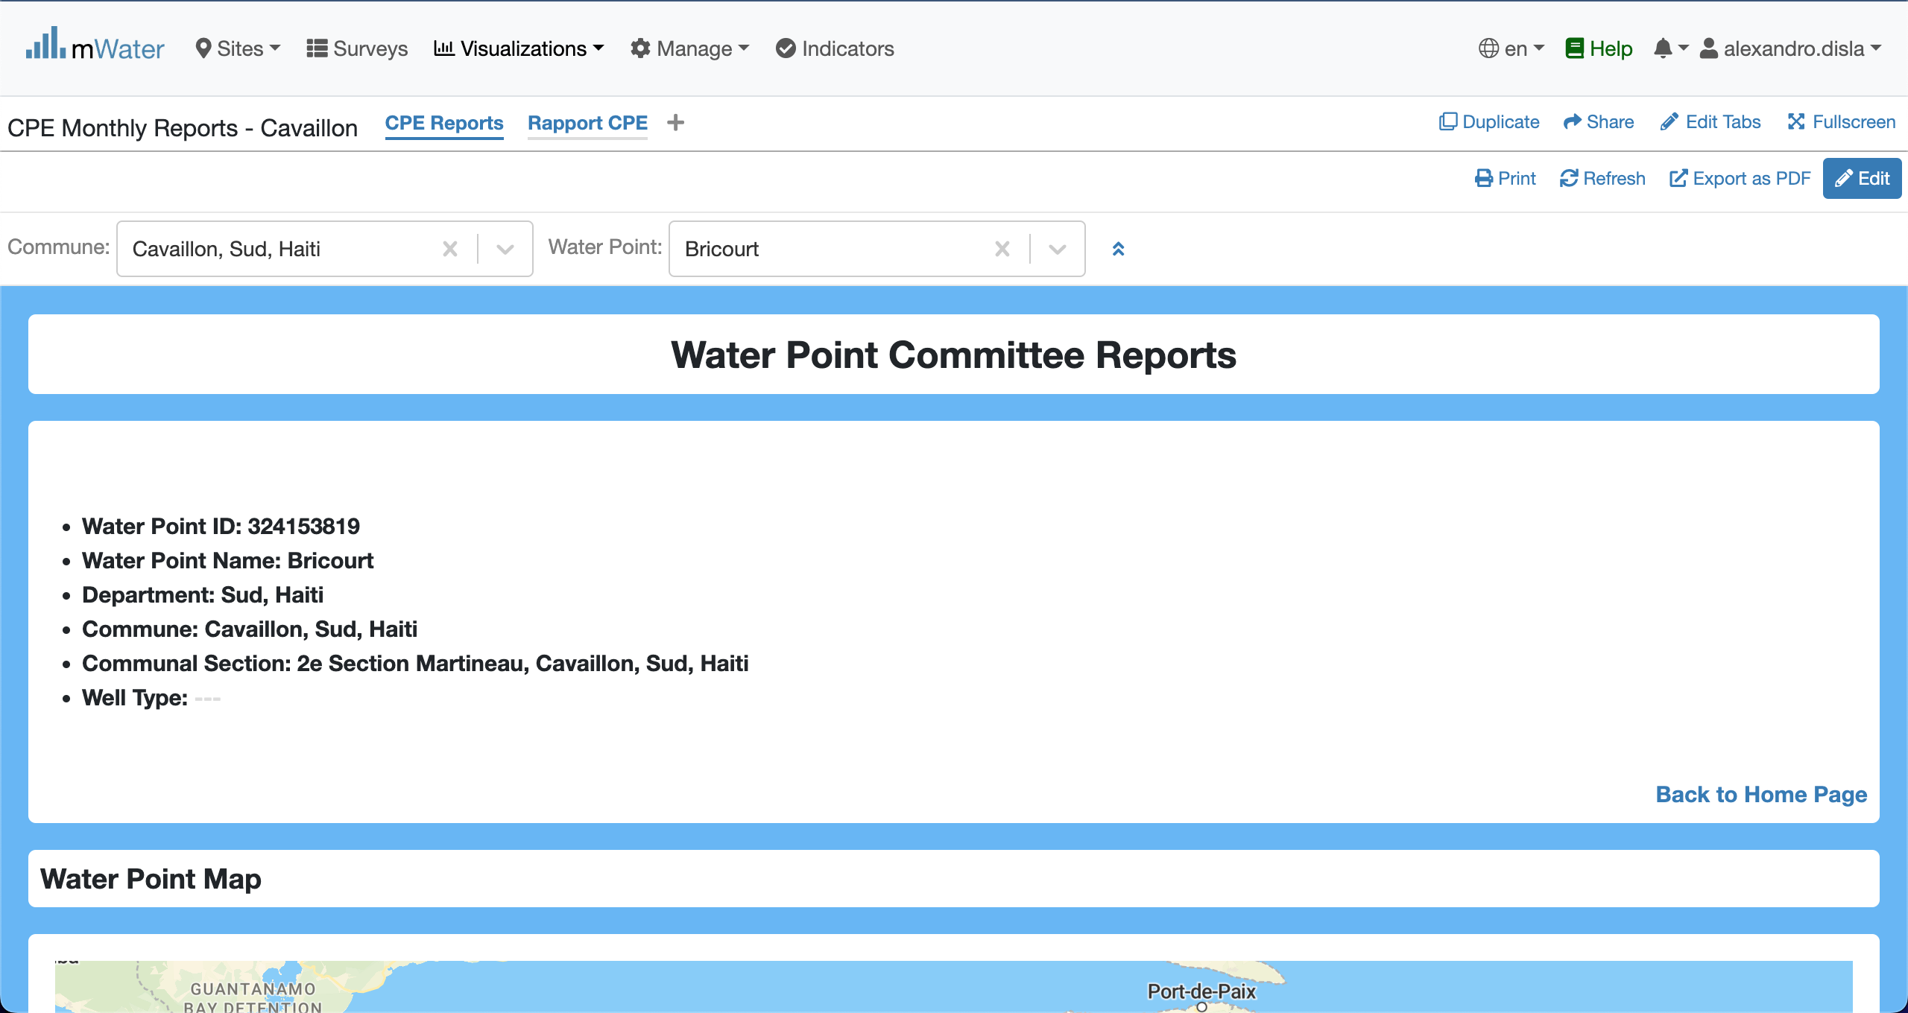
Other export options
The print and the export as pdf are the two standard way to export the results of the console into pdf. However, the export as pdf is recommanded because of his efficiency.
Don’t forget that the quick filters must be active. In order for the console to display the results.

Slide 30
Thank You !!!
PLEASE FEEL FREE TO CONTACT ME BY :
Email / alexandro.disla@hanwash.org
Whatsap or Phone / +50941483700

